Slide 1


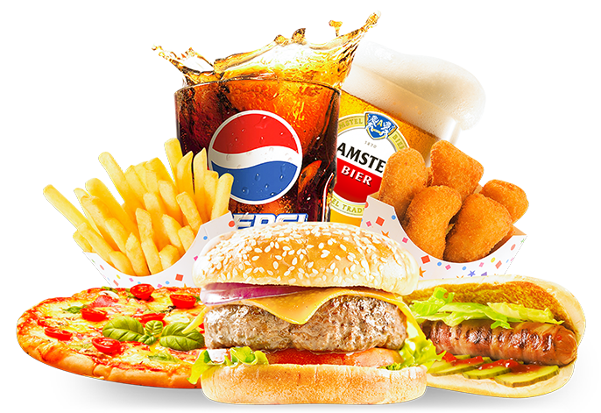

Powered BY

Slide 2
Team Members
Abhishek Yadav
Phadnis Simran
Tushar Vats
Rituraj Shukla
Kuldeep K. Mahto

Slide 3
Content/Modules
1. Introduction of zestible and Problems that we have addressed.
2.Unique filter
3. Delivery/Tracking
4. Revenue Model & Benefits
5.Small comparison
6.Prototype view of application

Slide 4

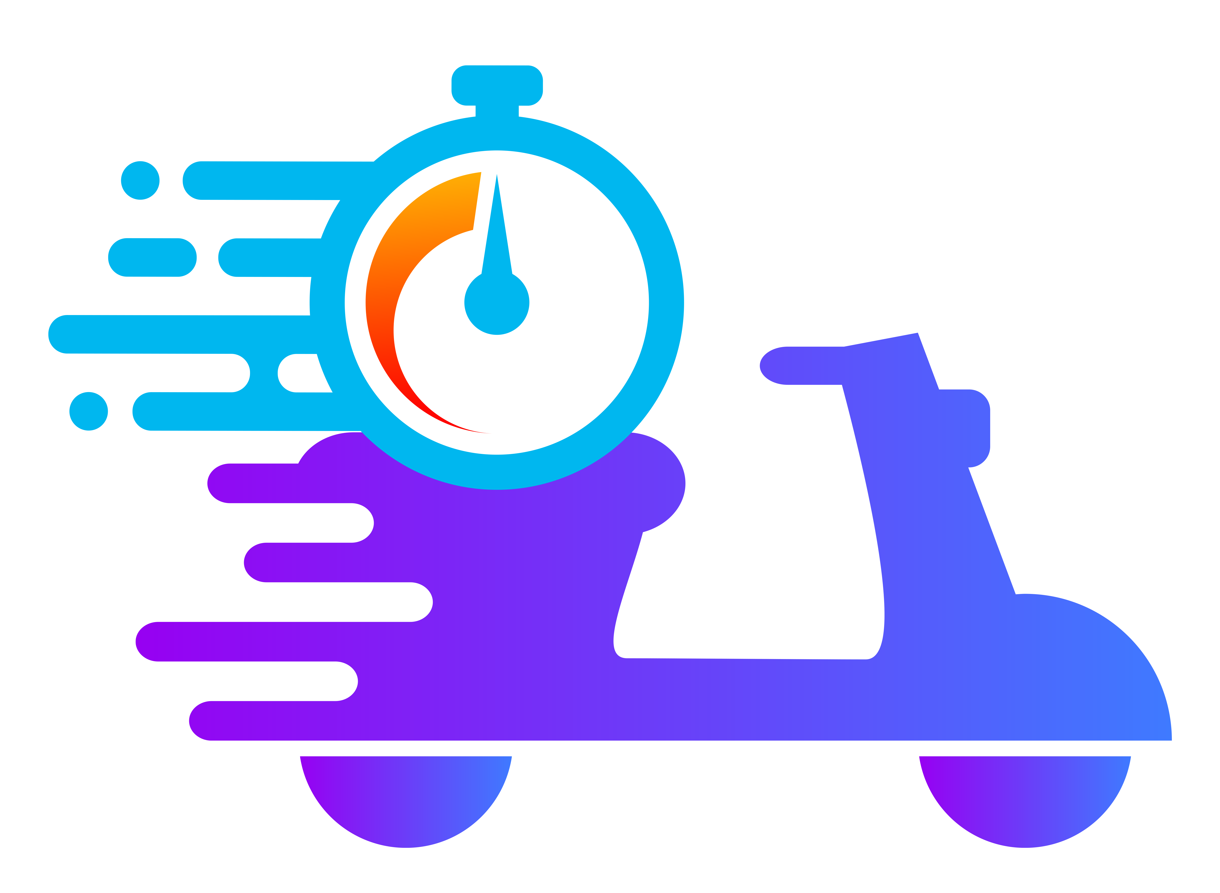

introduction
Zestible your ultimate food delivery application. Powered by the Open Network for Digital Commerce (ONDC) platform, Zestible is your passport to a world of gastronomic delights. What sets us apart is our innovative approach—we understand that taste is personal. That's why we've introduced a one-of-a-kind filter that customizes your selections based on your unique palate.
Problems that we have addressed.
Unique filter
Whole new delivery system
Better price then others

Slide 5
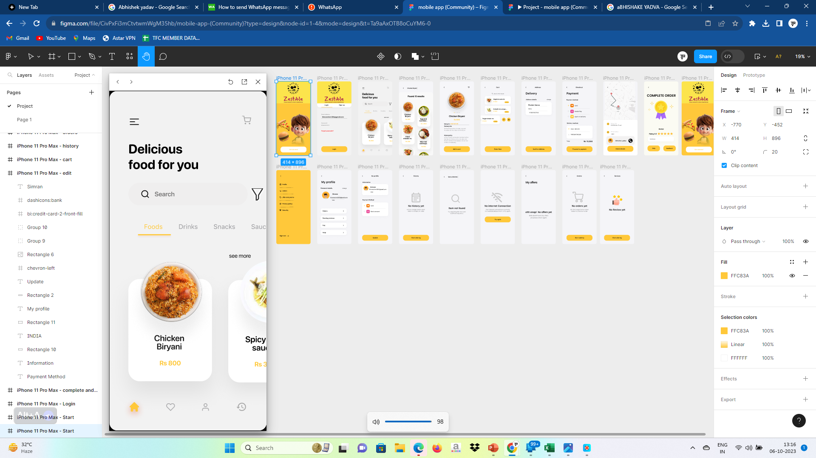
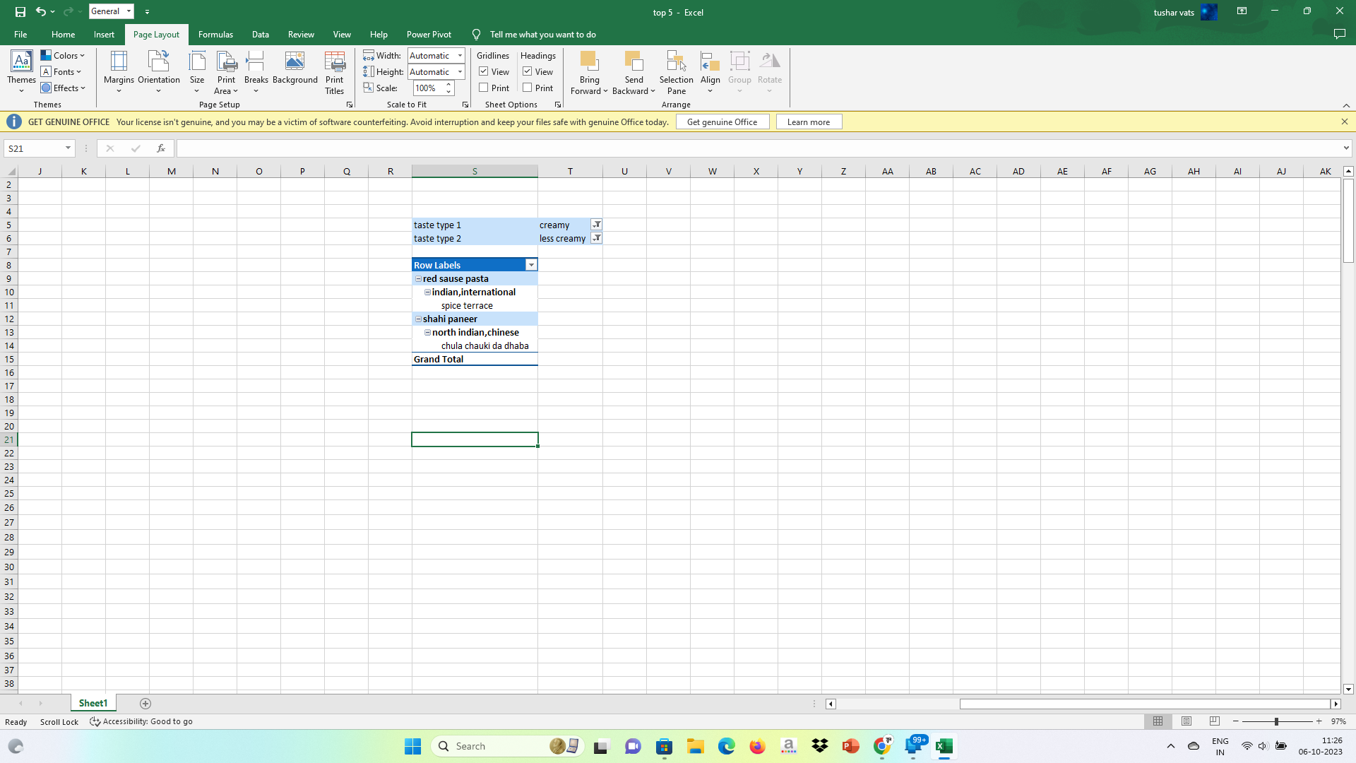
Unique filter
Our app is designed to cater to the needs of people who are health-conscious and have specific dietary requirements. With our new filter, users can easily find food that meets their dietary needs. Whether you are looking for less spicy, sugar free , or Shallow fry options, our app has got you covered.

Slide 6
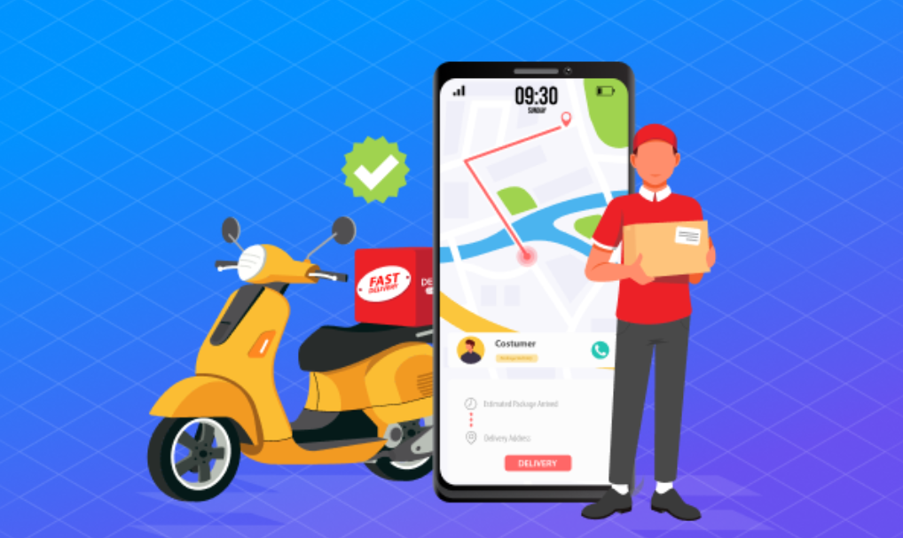
Delivery/Tracking
Revolutionize the delivery landscape with our cutting-edge system, built upon InDriver technology. Unlike traditional methods, we're introducing a Delivery Persons Interface Application that eliminates the need for acquiring more delivery personnel. With a streamlined KYC process and a security deposit Rs.800 deposit, we empower delivery heroes while optimizing routes through advanced tracking and analytics, ensuring businesses connect with customers like never before.

Slide 7
Revenue Model
Creating Value for users/customer
Unlock the best deals for delivery pros with our platform! Enjoy unbeatable commissions, exclusive filters for the best food by your tase, and a 0% platform fee.
Marketing
Solution
Less commission
Delivery
Online

Slide 8
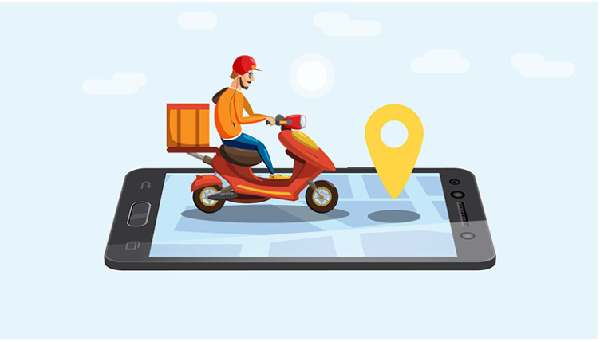
Benefits
Maintain a balanced number of rides daily for optimal performance. Increase incentives for successful deliveries. Acknowledge human errors and provide support. Operators achieving 100 deliveries swiftly will be promoted to a premium class, offering higher rewards and exciting benefits, including customizable incentives.

Slide 9



Small comparison FOR HEROS
Avg rides per day | N/A | 12 | 20
incentive/delivery | 45/del | 40/del | 40/del

Slide 10
Small comparison
PlatformCharges | INR 0 per order | INR 3 per order | INR 3 per order
commission | 10%-12% | 15%-22% | 15%-30%
Our food delivery app, powered by ONDC, keeps things simple and cost-effective. We charge only 10 to 13% for using our platform and, importantly, we don't burden you with any extra commissions. we're dedicated to providing you with top-notch tracking, reliable delivery, and responsive chat support. Enjoy easy, affordable, and hassle-free food delivery, all thanks to ONDC.

Slide 11
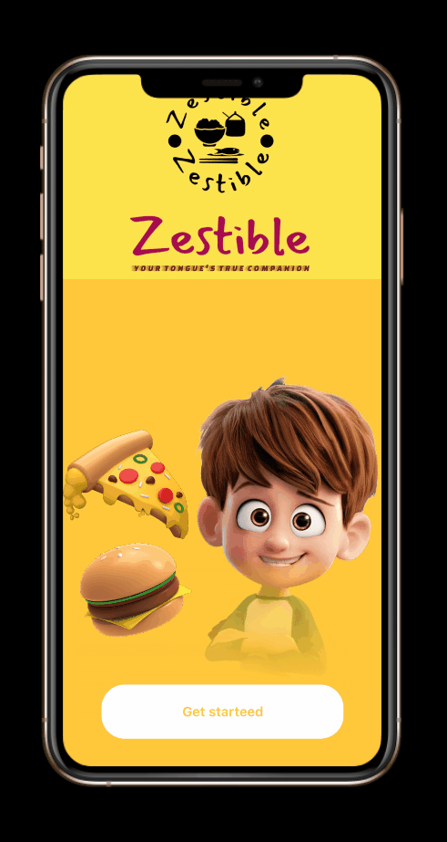
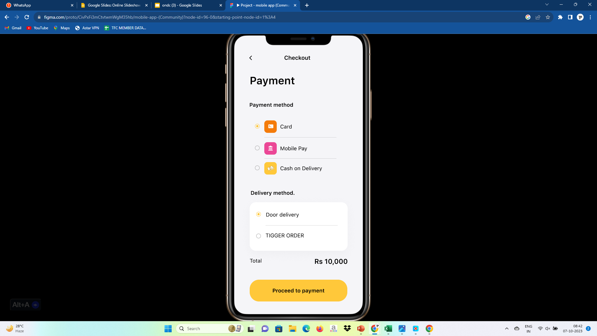
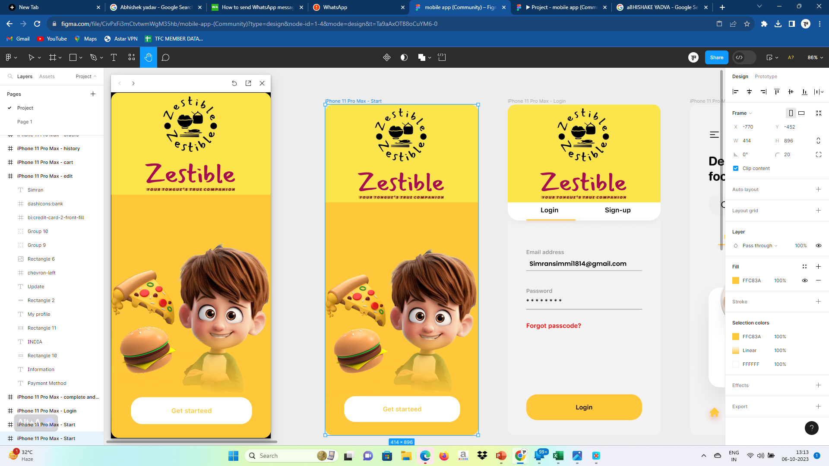
Prototype view of application

Slide 12
THANK YOU

